Slide 1


Facets Extensions
October 16, 2014
Presenters name, Title - Date

Slide 2
Agenda
Technology Overview
Steps to Register Extension with Facets
Extension Coding Process
Application Settings
Code Structure
Extension Data Object

Slide 3
Technology Overview
October 16, 2014

Slide 4
Technology Overview
XCOM
The recommended platform for the mainstream Facets extensions
Uses the same underlying architecture as the ‘legacy’ extensibility platforms
Exit Services Application
Extensions Macros
Exit Points
Universally applies to all Facets applications
The extension itself is a COM Component

Slide 5
Technology Overview
Facets Client
Facets Application
(e.g. SBSB)
XCOM Services Stub
Application Data
Extension Data
Object
Standard COM
In Process
XCOM Extension

Slide 6
Technology Overview
XCOM Extension Services Application
Also known as XCOM Services Stub
Instantiates the Extension Data Object
Facilitates communication
Invoked by other Facets apps to call an extension; never invoked directly by user
Module ID is ‘XCOM’
Default App ID is ‘XCOM’
DLL is CERLXCOMnnn.dll

Slide 7
Technology Overview
Extension Development Steps
Register extension with Facets
Create extension Macro
Select Application(s)/Event(s) for the Macro
Code extension logic

Slide 8
Register Extension
October 16, 2014

Slide 9

Register Extension
Create extension Macro
Open “System Extension Maintenance” app
File/Open – Product=FA, AppId=XCOM (or equivalent)
In Exit Macro section, select Edit…Add Macro. Select a name for your macro.
Add appropriate macro instructions, and save.
Macro text is case/white space sensitive!

Slide 10
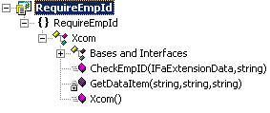
Register Extension
Create extension Macro (continued)
Destination = COM method to execute

Slide 11
Register Extension
Create extension Macro (continued)
Object = Prog ID of the COM class
[ComVisible(true)]
[ProgId("RequireEmpId.Xcom")]
[ClassInterface(ClassInterfaceType.None)]
public class Xcom
{

Slide 12
Register Extension
Create extension Macro (continued)
Action :
Continue: macro continues on next line
ExternalCall: macro is complete (last line)

Slide 13
Register Extension
Create extension Macro (continued)
Parameters Parameters are separated by spaces if on the same line.
/DataId: single-instance data to pass to extension. Ex: /DataId=CLCL
/DataIdAll: multi-instance data to pass to extension. Ex: /DataIdAll=CDML
/DataIdEx: for write-only data, e.g. REPROC
Each DataId-like parameter must be on its own line in the macro!

Slide 14
Register Extension
Create extension Macro (continued)
Parameters
/Style:
N: Extension may not update Facets data
U: Extension may update Facets data

Slide 15
Register Extension
Create extension Macro (continued)
Parameters
/Return:
I: Facets ignores the extension return value
E: Facets respects the extension return value

Slide 16
Register Extension
Create extension Macro (continued)
Parameters
/Interactive:
N: Extension has no GUI - must use this for batch extensions.
Y: Extension has a GUI

Slide 17
Register Extension
Create extension Macro (continued)
Parameters
/Signon:
N Do not include signon info in context data
Y Include signon info in context data
$$SGN0++ Include signon+password info in context data
…

Slide 18
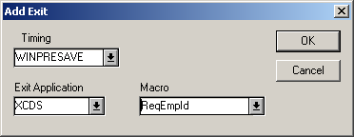
Register Extension
Select Application(s)/Event(s) for the Macro
Open “Application Maintenance” app
File/Open: Product=FA, AppId=SBSB (or equivalent)
For system/application generated events:
Go to Exits section; select Edit/Add
Select desired event, your app, and macro
File/Save

Slide 19
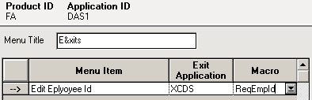
Register Extension
Select Application(s)/Event(s) (continued)
For user generated events:
Go to Exit Menu section
Add a menu title if empty(&’s are respected)
Enter menu item, app, and macro in grid
File/Save

Slide 20
Coding Process
October 16, 2014

Slide 21
Coding Process
Development Environment:
Any language that supports COM
TriZetto Recommends the following languages.
C# .NET
Visual Basic .NET
Visual C++ .NET
Samples in this presentation use C# and Visual Studio 2010.
Check for compatibility between your Facets version and your .NET version!

Slide 22
Coding Process
Create New Project
Create a new C# Class Library project in Visual Studio .NET.
For consistency, project name should match Application name used in “Object” column in extension macro (e.g. RequireEmpID).

Slide 23
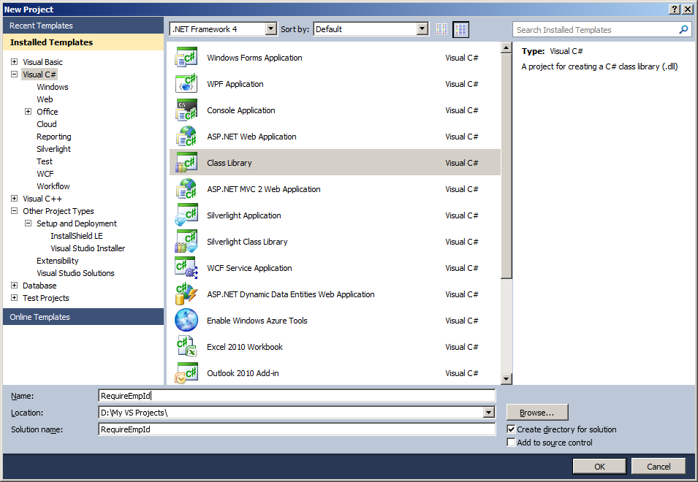
Coding Process

Slide 24
Coding Process
Set Project Properties
Right-click on project in Solution Explorer; select Properties
Navigate to “Build”
Check “Register for COM Interop” option on
Click OK

Slide 25
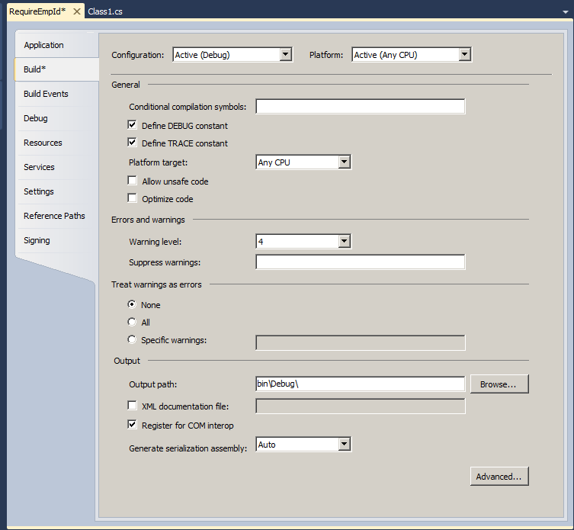
Coding Process

Slide 26
Coding Process
Set Project Properties (continued)
To facilitate debugging:
While in the Project Property Pages, navigate to “Debugging”
In “Start Action” section:
Check “Start external program” option on
Set “Start Application” to location of Facets client executable e.g. D:\TriZetto\Facets\510\System\Bin\ceraexe0510.exe

Slide 27
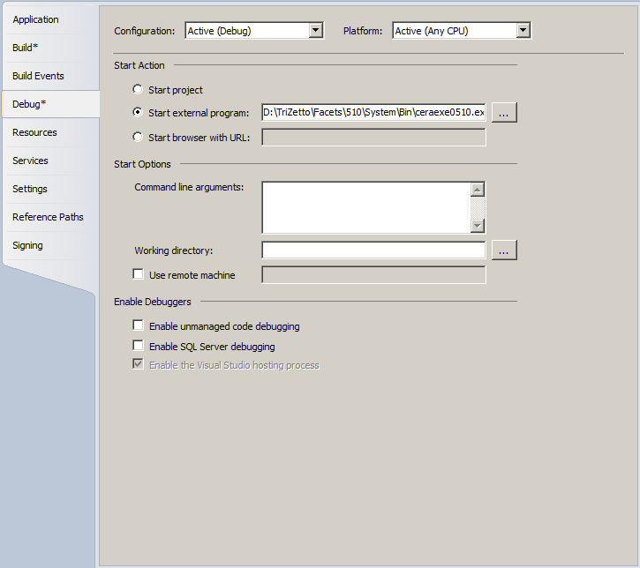
Coding Process

Slide 28
Coding Process
Add Reference
Right-click on References in Solution Explorer; select Add Reference
Click Browse...
Browse to Facets Interfaces directory, e.g. C:\Program Files (x86)\Common Files\Trizetto\Interfaces\
Select ErCoreIfcExtensionData.dll

Slide 29
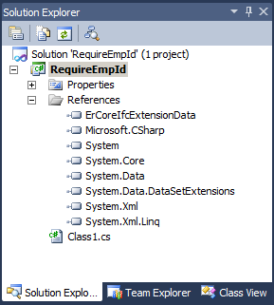
Coding Process

Slide 30
Coding Process
Create New Class
Create a new public class in your project.
For consistency, class name should match class name used in “Object” column in extension macro.
Note!
You may need to set ComVisibleAttribute to true.
public class Xcom
{
public Xcom()
{
} //constructor
} //class Xcom

Slide 31
Coding Process
Add Method
Create a new public method within the class.
Method name must match name used in “Destination” column of extension macro (e.g. CheckEmpID).
It must take two arguments by value:
ErCoreIfcExtensionData.IFaExtensionData
string
Return type must be bool
Any method referenced by a Facets extension macro must adhere to this signature.
Different extension macros may reference many public methods within a single class (i.e., multiple extensions within a single COM server).

Slide 32
Coding Process
using ErCoreIfcExtensionData;
...
public class Xcom
{
...
public bool CheckEmpID(IFaExtensionData extData, string facetsID)
{
...
//Add Extension Business Logic Here!
//If errors, return false, otherwise return true
...
return true;
} //CheckEmpID
...
} //class Xcom

Slide 33
Extension Data Object
October 16, 2014

Slide 34
Extension Data Object
Provided by TriZetto in order to
Expose Facets status and data to the extension
Allow access to some Facets resources, such as database connection
Facilitate error handling
Passed by Facets to an XCOM extension via the XCOM method’s first argument
Class name: ErCoreIfcExtensionData.IFaExtensionData
DLL name: ErCoreClbExtension###.dll
RCW (Interop assembly) facilitates access to the Extension Data Object from .NET assemblies.

Slide 35
Extension Data Object
DbAvailable Property
Read-only
Type: bool
true: Database access available
false: Database access not available

Slide 36
Extension Data Object
Interactive Property
Read-only, reflects the value of the macro parameter /Interactive
Type : bool
true: Extension may operate interactively
false: Extension may not operate interactively

Slide 37
Extension Data Object
LastMessage Property
Read-only
Type : string
Returns last informational message from object

Slide 38
Extension Data Object
LastResult Property
Read-only
Type : bool
Returns result of last method invoked
true: method execution was successful
false: method execution was unsuccessful

Slide 39
Extension Data Object
ReadWrite Property
Read-only, reflects the value of the macro parameter /Style
Type : bool
true: Extension may ”Get” data from Facets and may “Set” updated data back to Facets
false: Extension may only ”Get” data from Facets

Slide 40
Extension Data Object
GetData Method string GetData(string dataId)
Returns XML string containing requested data.
If dataId is specified, only that data will be returned.
If dataId == "", ALL data available to extension will be returned

Slide 41
Extension Data Object
GetData Method Example
public bool CheckEmpID(IFaExtensionData extData, string facetsID)
{
...
string allData, sbsbData;
sbsbData = extData.GetData("SBSB"); //Only SBSB data
allData = extData.GetData(""); //All data
...
return true;
} //CheckEmpID

Slide 42
Extension Data Object
GetData Method Output - Single Row
<FacetsData>
<Collection name="SBSB" type="Group">
<Column name="_Class">CMC_APPREC_SBSB</Column>
<Column name="_Lib">cmelrec0400.dll</Column>
<Column name="_Modified">0</Column>
<Column name="_AccessFunc">0</Column>
<Column name="LOCK_TOKEN">1</Column>
<Column name="SBSB_CK">6550</Column>
<Column name="GRGR_CK">3</Column>
<Column name="SBSB_ID">301080999</Column>
...
<Column name="SBSB_PAY_FSAC_METH">S</Column>
<Column name="SBSB_LOCK_TOKEN">0</Column>
<Column name="ATXR_SOURCE_ID">01/05/1753 00:00:00.000</Column>
</Collection>
</FacetsData>

Slide 43
Extension Data Object
GetData Method Output - Multi Row
<FacetsData>
<Collection name="SBAD" type="Group">
<SubCollection name="SBAD" type="Row">
<Column name="_Class">CMC_APPREC_SBAD</Column>
<Column name="_Lib">cmelrec0400.dll</Column>
<Column name="_Modified">1</Column>
...
<Column name="SBAD_LOCK_TOKEN">0</Column>
<Column name="ATXR_SOURCE_ID">NULL</Column>
</SubCollection>
<SubCollection name="SBAD" type="Row">
<Column name="_Class">CMC_APPREC_SBAD</Column>
<Column name="_Lib">cmelrec0400.dll</Column>
<Column name="_Modified">0</Column>
...
<Column name="SBAD_LOCK_TOKEN">0</Column>
<Column name="ATXR_SOURCE_ID">NULL</Column>
</SubCollection>
</Collection>
</FacetsData>

Slide 44
Extension Data Object
GetData Method Output – Multi Group
<FacetsData>
<Collection name="SBSB" type="Group">
<Column name="_Class">CMC_APPREC_SBSB</Column>
<Column name="LOCK_TOKEN">1</Column>
<Column name="SBSB_CK">6550</Column>
<Column name="GRGR_CK">3</Column>
...<Column name="SBSB_LOCK_TOKEN">0</Column>
<Column name="ATXR_SOURCE_ID">01/05/1753 00:00:00.000</Column>
</Collection>
<Collection name="SBAD" type="Group">
<SubCollection name="SBAD" type="Row">
<Column name="_Class">CMC_APPREC_SBAD</Column>
<Column name="LOCK_TOKEN">1</Column>
<Column name="ADDR1">1700 Broadway</Column>
...<Column name="ATXR_SOURCE_ID">NULL</Column>
</SubCollection>
<SubCollection name="SBAD" type="Row">
<Column name="_Class">CMC_APPREC_SBAD</Column>
<Column name="LOCK_TOKEN">1</Column>
...<Column name="ATXR_SOURCE_ID">NULL</Column>
</SubCollection>
</Collection>
</FacetsData>

Slide 45
Extension Data Object
GetContextData Method string GetContextData(string dataId)
Returns XML string containing context data.
If a dataId is specified, only that data will be returned
If dataId == "", all context data will be returned

Slide 46
Extension Data Object
GetContextData Method Example
public bool CheckEmpID(IFaExtensionData extData, string facetsID)
{
...
string ctxData;
ctxData = extData.GetContextData("");
...
return true;
} //CheckEmpID

Slide 47
Extension Data Object
GetContextData Method Output
<FacetsData>
<Column name="REGION_ID">&lt;NULL&gt;</Column>
<Column name="REGION_LOC">&lt;NULL&gt;</Column>
<Column name="PZAP_APP_ID">SBSB</Column>
<Collection name="EXIT" type="Group">
<Column name="TIMING">WINPRESAVE</Column>
<Column name="PZAP_APP_ID">XCOM</Column>
<Column name="SYIN_INST">108448</Column>
</Collection>
<Collection name="SGN0" type="Group">
<Column name="PZPZ_ID">FA</Column>
<Column name="USUS_ID">ERISCO</Column>
<Column name="DATA_SOURCE_ID">sampledb.corp.trizetto.com</Column>
<Column name="DATABASE_ID">facetsuser</Column>
<Column name="SIGNON_PASSWORD">erisco</Column>
<Column name="MANGLED_PASSWORD">erisco</Column>
</Collection>
</FacetsData>

Slide 48
Extension Data Object
GetDbRequest Method string GetDbRequest(string sql)
Submits SQL query to Facets database using connection open by Facets client.
Supports a wide range of SQL queries.
Both read and update queries are supported.
Query can contain multiple SQL statements, except on Oracle. On Oracle, multi-statement queries can be placed in a PL/SQL function invoked via this special syntax: EXECUTE function_name @pPAR1, @PAR2... ;
Result set (result cursor on Oracle) and/or error messages are returned in XML format.
Not recommended if large volume of returned data is expected.
Query must be terminated with a semicolon.

Slide 49
Extension Data Object
GetDbRequest Method Example 1 (SELECT)
string resultSet = extData.GetDbRequest(
"SELECT SBSB_FIRST_NAME, SBSB_LAST_NAME " +
"FROM CMC_SBSB_SUBSC WHERE SBSB_MCTR_VIP <> ' '; ");
<FacetsData>
<Column name="RETURN_CODE">0</Column>
<Column name="SQL_ERROR_CODE">0</Column>
<Column name="NUM_RESULTS">2</Column>
<Column name="ERROR_MESSAGE"></Column>
<Column name="SQL_ERROR_MESSAGE"></Column>
<Collection name="DATA" type="Row">
<Column name="SBSB_FIRST_NAME">Joe</Column>
<Column name="SBSB_LAST_NAME">Montana</Column>
</Collection>
<Collection name="DATA" type="Row">
<Column name="SBSB_FIRST_NAME">John</Column>
<Column name="SBSB_LAST_NAME">Elway</Column>
</Collection>
</FacetsData>

Slide 50
Extension Data Object
GetDbRequest example 2 (error)
string resultSet = extData.GetDbRequest(
"SELECT Nonexistent_Column from CMC_SBSB_SUBSC;");
<FacetsData>
<Column name="RETURN_CODE">8</Column>
<Column name="SQL_ERROR_CODE">904</Column>
<Column name="NUM_RESULTS">0</Column>
<Column name="ERROR_MESSAGE">SQLExecute - SQLExecDirect failed</Column>
<Column name="SQL_ERROR_MESSAGE[Oracle][ODBC][Ora]ORA-00904: "NONEXISTENT_COLUMN": invalid identifier
</Column>
</FacetsData>

Slide 51
Extension Data Object
GetDbRequest example 3 (UPDATE)
string resultSet = extData.GetDbRequest(
"UPDATE CMC_KYLK_KEY_LOCK SET KYLK_LOCK_TOKEN = 1;");
<FacetsData></FacetsData>

Slide 52
Extension Data Object
SetData Method bool SetData(string dataId, string data)
Submits request to update data in Facets application memory.
If dataId is specified, only that collection may be passed.
If dataId = "", all data must be passed!
Returns true if update request was successfully accepted.
Submitted data does not get updated to Facets application until after extension terminates
There is no guarantee of a successful update, even if the method returns true and the LastResult/LastMessage properties indicate success.
Recommended practice: execute SetData only once – immediately prior to returning from the XCOM method.

Slide 53
Extension Data Object
bool AddMessage(int severity, int code, string text)
Posts Message to Facets
Displayed to user by Facets after extension terminates (up to 5 messages displayed at a time; multiple dialogs if more than 5 messages posted)

Slide 54
Assignment
October 16, 2014

Slide 55
Assignment
You are asked write a XCOM Extension. This extension should be invoked from the Medical Claims Processing application. The requirements are as follows…
The extension should be invoked when a claim is adjudicated by pressing F3.
The extension evaluates [Micro /Image ID] field.
If this field is not populated, the extension prompts a message, and returns false.
Otherwise, the extension returns true.

Slide 56
Q & A
October 16, 2014

